Slide 1
LMMS Experiment
Creating a Melody Loop in Piano Roll

Slide 2
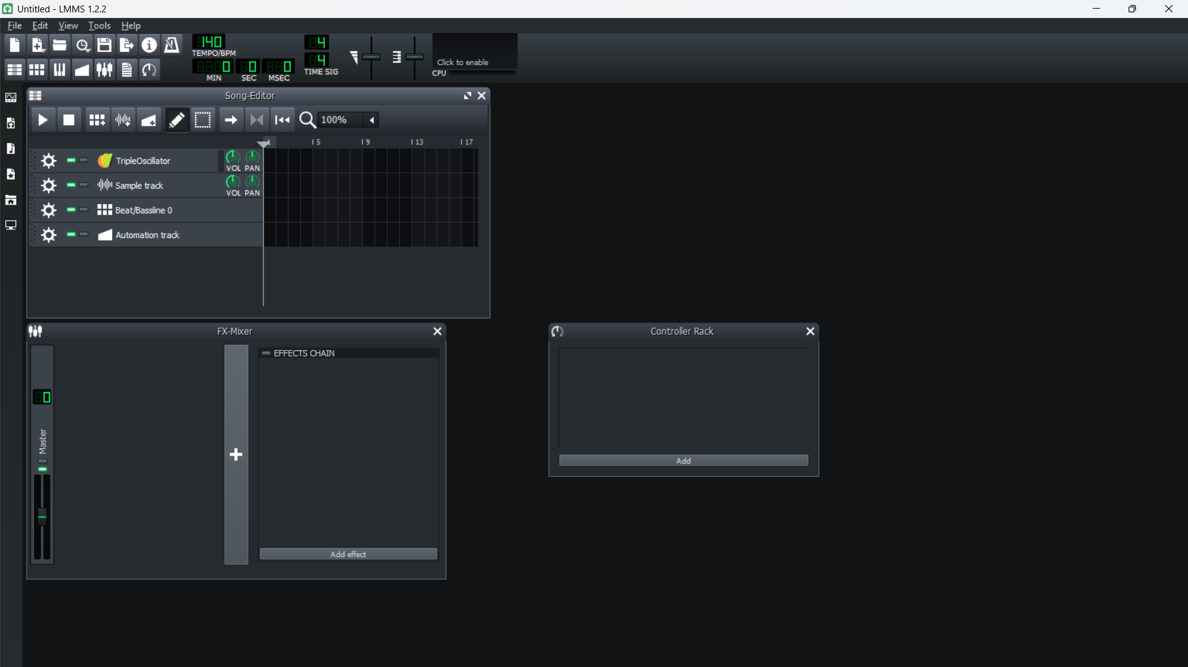

Slide 3
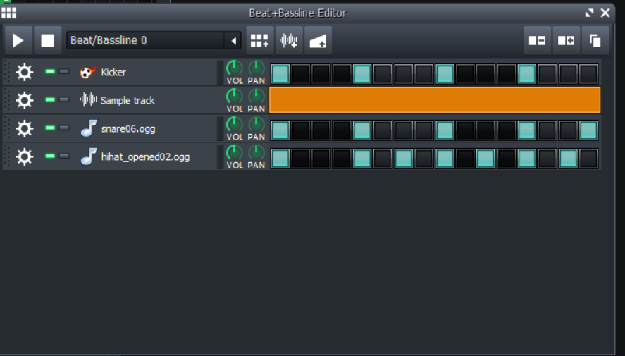
From the first image clicking on beat/baseline we are creating a basic drum sound loop by adding kicker , snare , h-hat. And by making the notes high as per the quality.

Slide 4
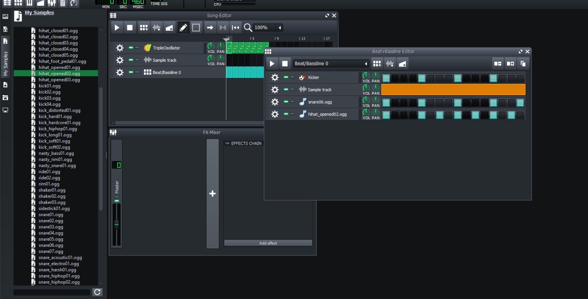
Snare and h-hat are added from my sample/drum from left side panel

Slide 5
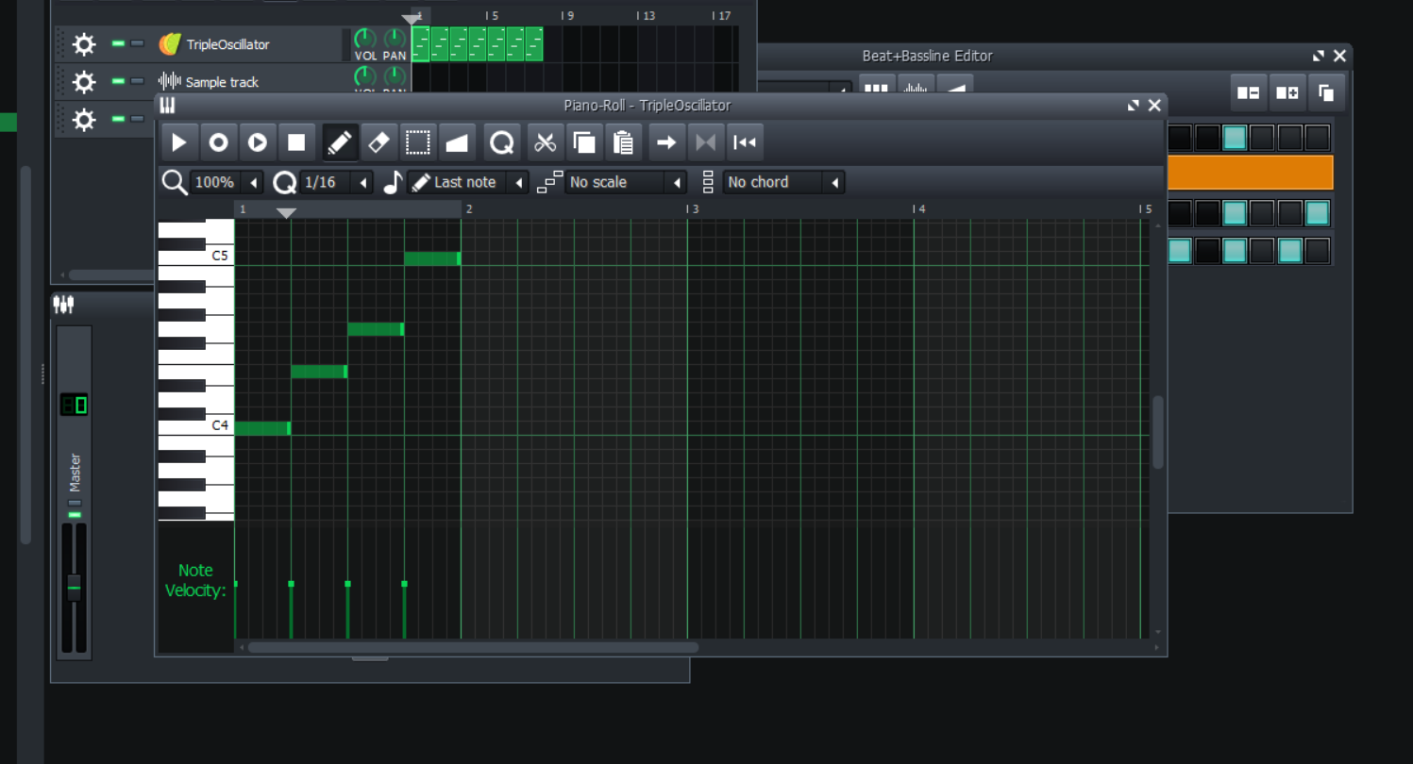
After that I am creating melodies from piano roll by setting notes notes (C4, E4, G4, C5) from C major scale.

Slide 6
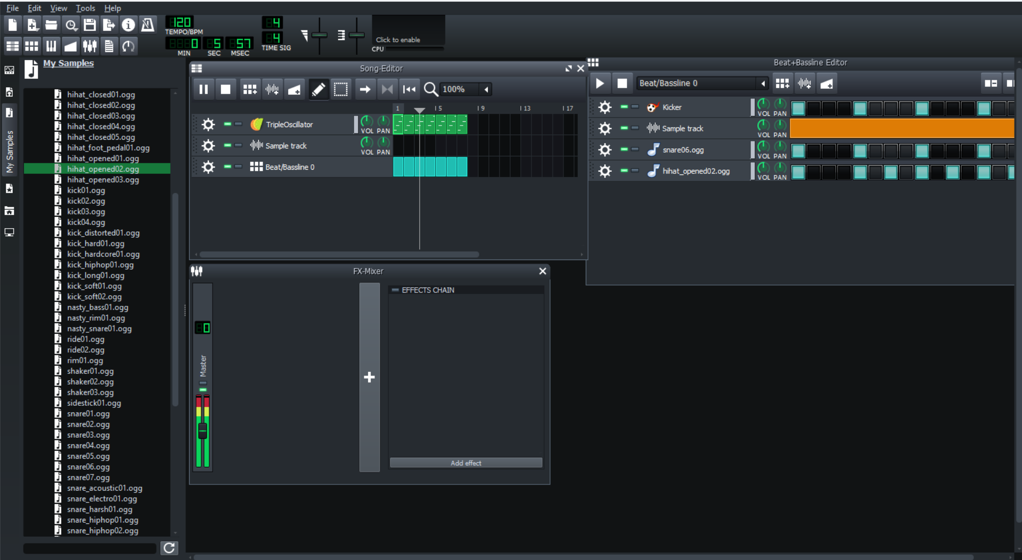
And at last we are summing up and playing all beat base and piano melody together to form some sounds and as need make the changes.

